Slide 1
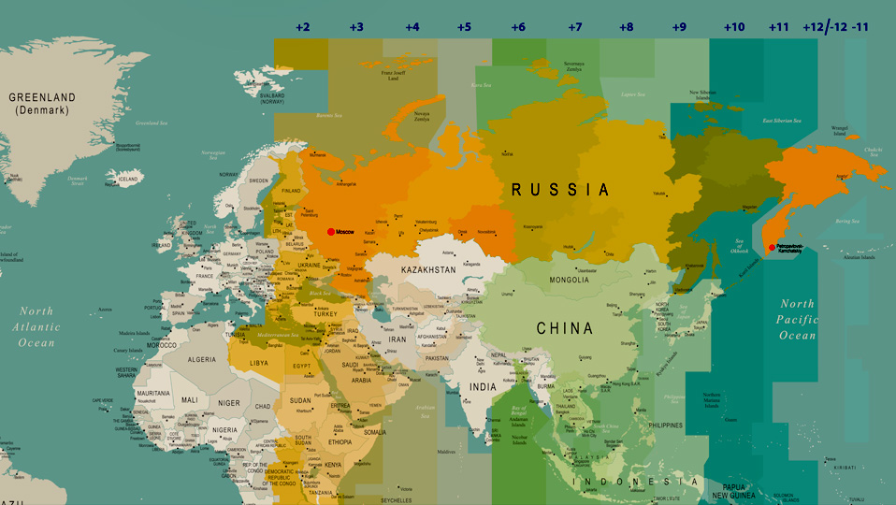
10am in Moscow
7pm in Kamchatka
Not one, not two… but 11 time zones

Slide 2
Title here
2. Differences
Moscow
St. Petersburg

Slide 3
Title here
2. Differences
Australia
Barcelona
Sydney Opera House
La Sagrada Família

Slide 4
2. Differences
Moscow
St. Petersburg

Slide 5
2. Differences
Australia
Barcelona
Sydney Opera House
La Sagrada Família

Slide 6
Title here
2. Differences
Moscow
St. Petersburg
St. Petersburg

Slide 7
2. Differences
Moscow
St. Petersburg
St. Petersburg

Slide 8
Internet usage stats
85% of Russian internet users access the internet every day (vs. 86% in the US).
Average daily time online is almost 6.5 hours.
90% of internet users stream video content – YouTube leads the way.
21% of internet users search with voice commands.

Slide 9
Internet usage stats
85% of Russian internet users access internet every day (vs. 86% in the US).
Average daily time online is almost 6.5 hours.
90% of internet users stream video content – YouTube leads the way.
St. Petersburg

Slide 10
CTAs
Direct CTAs like “Buy Today”, “Don’t Miss Out” etc… can have a negative impact.
Focusing more on the benefits and features can be more successful or less hard to sell, such as “Contact us” or “Learn more”.
Notes:
Change the colour of this background image: right click on the image > Format Picture… > choose the picture icon (top right) > Recolor > choose from the options provided

Slide 11
Key takeaways...
Data is your best friend.
Run all the A/B tests.
Be patient.
Treat each market as unique.
Notes:
Change the colour of this background image: right click on the image > Format Picture… > choose the picture icon (top right) > Recolor > choose from the options provided

Slide 12
Poll: Do you run an e-commerce business?
A
No.
B
I used to.
C
I would like to.
Notes:
Change the colour of this background image: right click on the image > Format Picture… > choose the picture icon (top right) > Recolor > choose from the options provided

Slide 13
Ten need-to-know facts about Russia
1
size
2
it varies
3
time spent online
4
dominated by local platforms
5
different seasonality

Slide 14
Ten need-to-know facts about Russia
6
Russians speak Russian
7
quality matters
8
transliteration will happen
9
cross-border shopping is big
10
price and deals are key

Slide 15
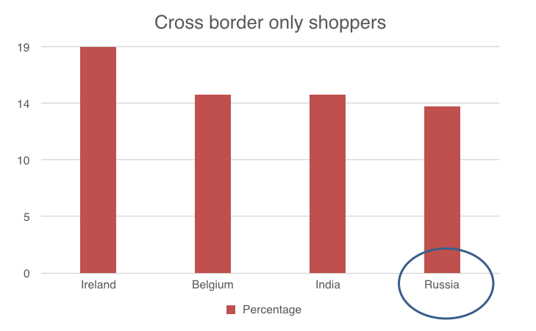
Cross border only shoppers

Slide 17
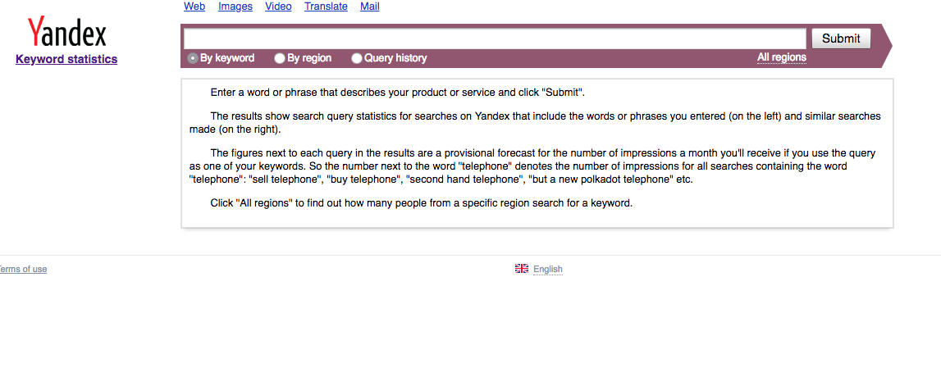
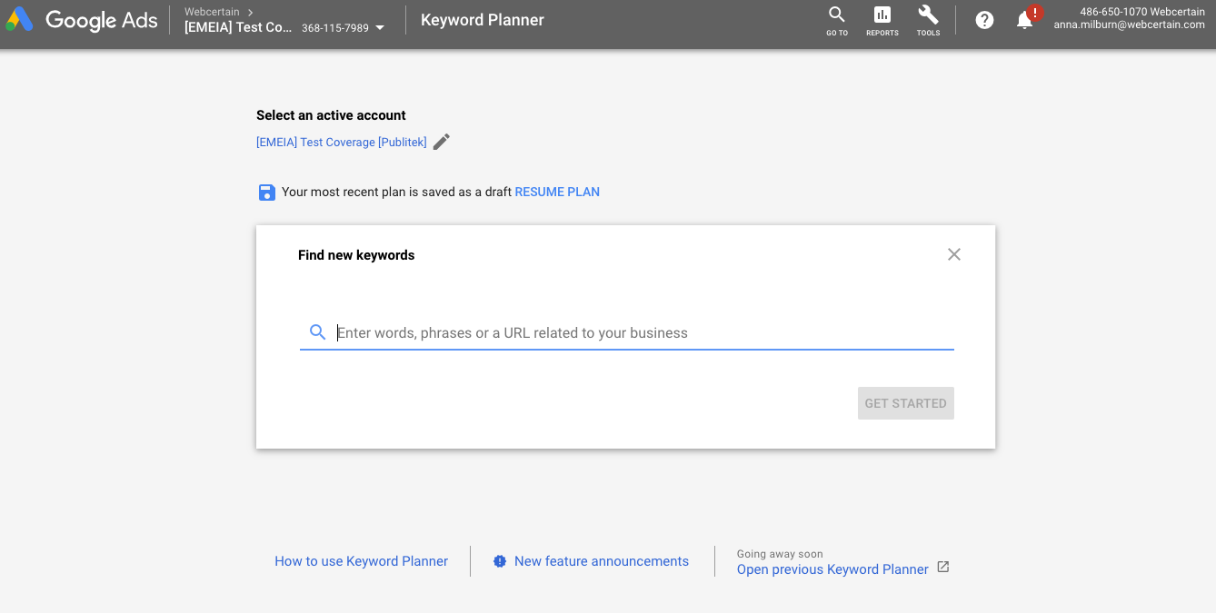
Title here
Yandex Wordstat
Google Keyword Planner
Notes:
Show contrast against the white screengrabs by changing the background colour of the slide to #EEEEEE

Slide 18
Yandex Wordstat
Google Keyword Planner
Notes:
Show contrast against the white screengrabs by changing the background colour of the slide to #EEEEEE

Slide 19
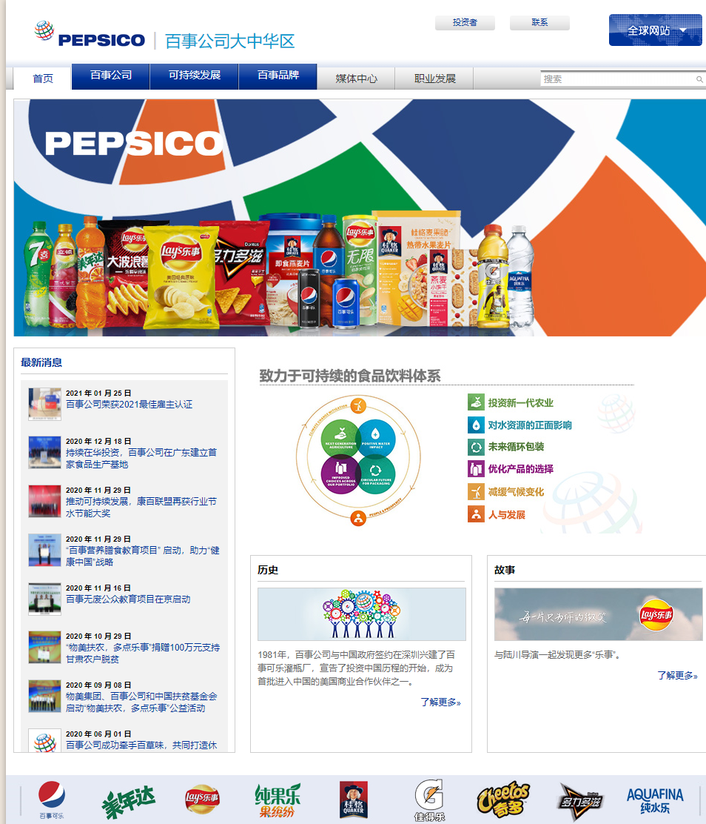
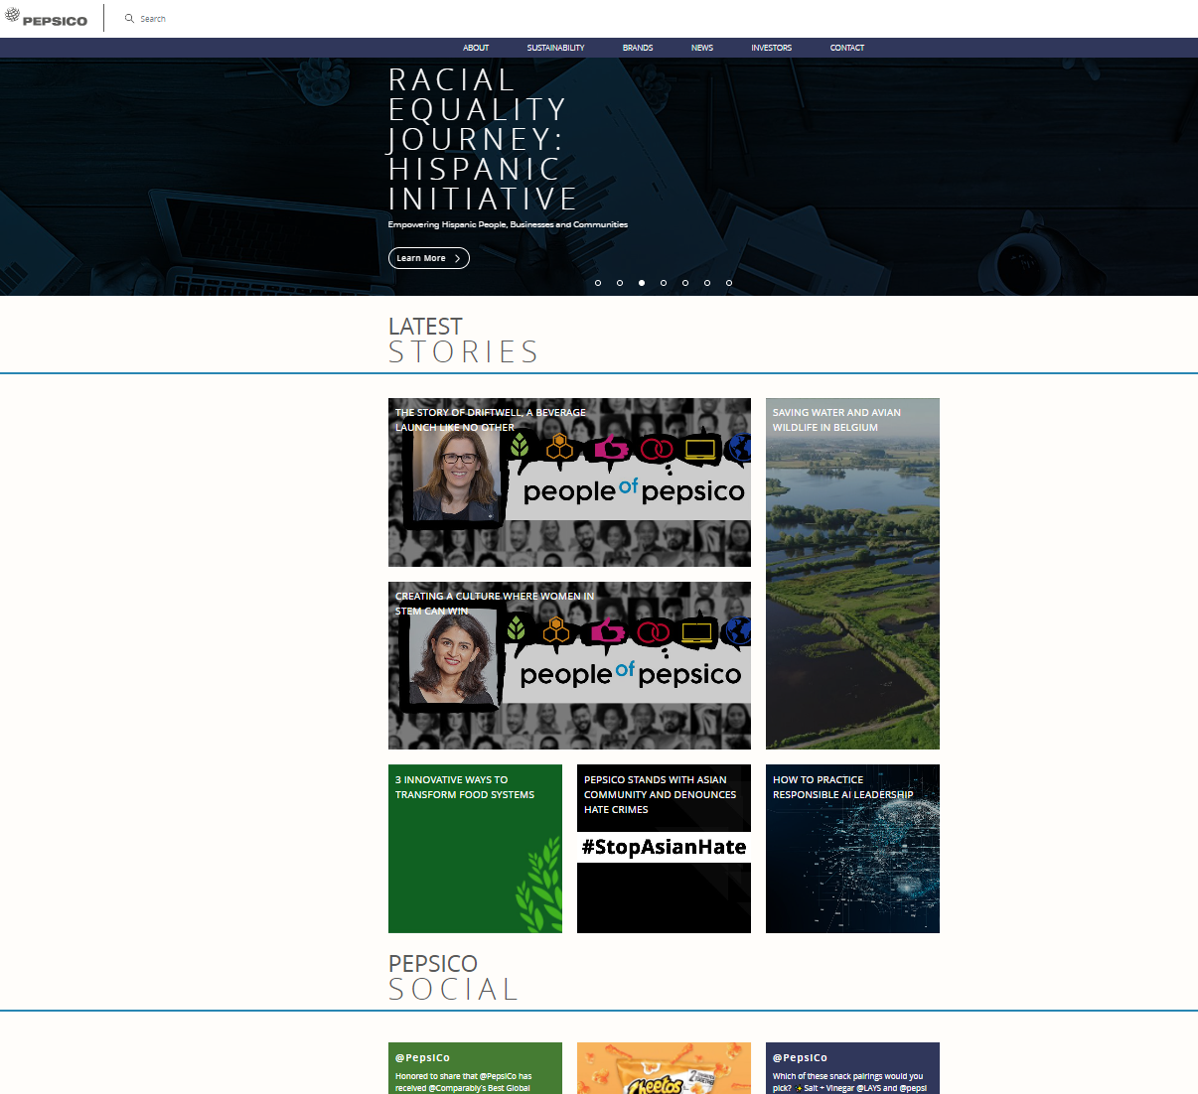
PepsiCo China
vs.
PepsiCo US
Notes:
Show contrast against the white screengrabs by changing the background colour of the slide to #EEEEEE

Slide 20
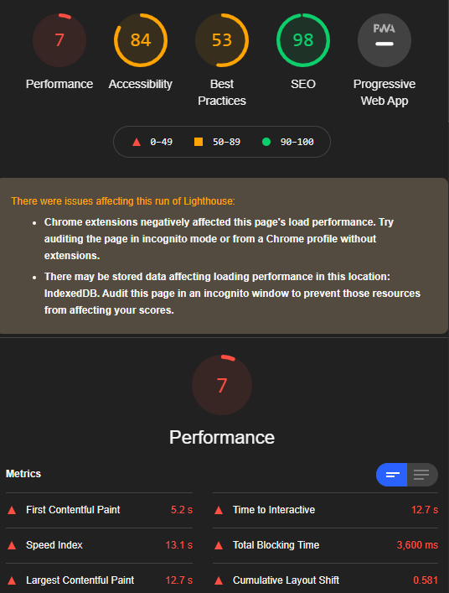
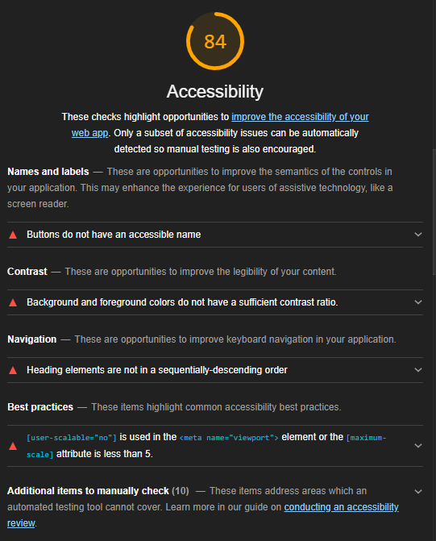
Google Lighthouse (qualitative)
Notes:
Show contrast against the white screengrabs by changing the background colour of the slide to #EEEEEE

Slide 21
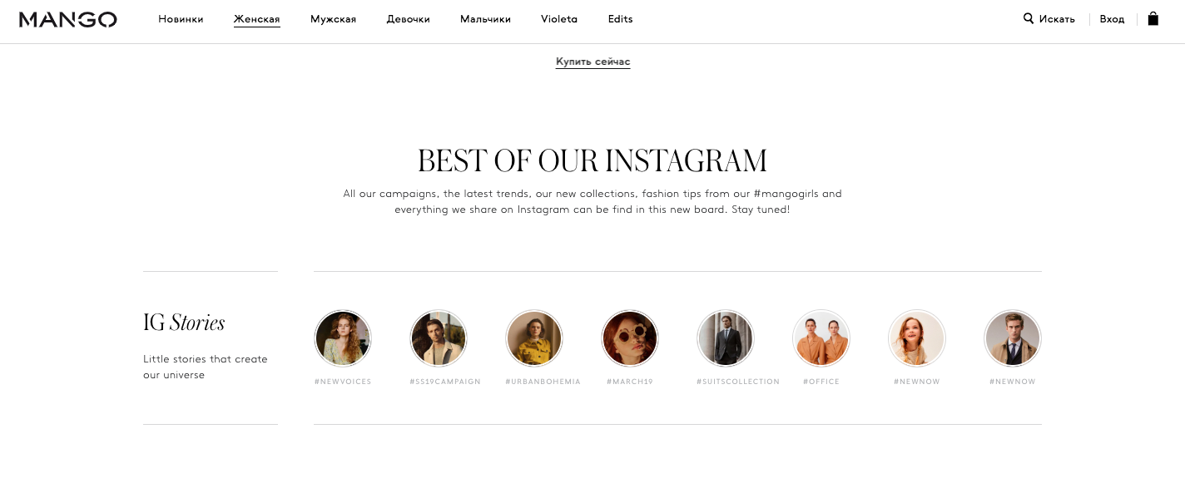
The whole website
Notes:
Show contrast against the white screengrabs by changing the background colour of the slide to #EEEEEE

Slide 22
Google Analytics (quantitative)
Notes:
Show contrast against the white screengrabs by changing the background colour of the slide to #EEEEEE

Slide 23
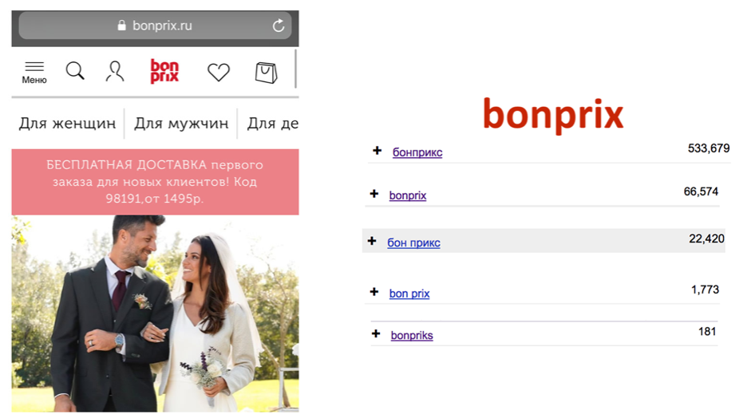
Notes:
Show contrast against the white screengrabs by changing the background colour of the slide to #EEEEEE

Slide 24
Does your site mention?
how to place an order
payment options
delivery options
suitable currency

Slide 25
Or alternative contact details?
Notes:
Show contrast against the white screengrabs by changing the background colour of the slide to #EEEEEE

Slide 26
A title here maybe?
Paid analytics tools

Slide 27
A title here maybe?
Paid analytics tools
Maecenas cursus nunc pretium, efficitur lacus eu, malesuada ipsum.
Maecenas cursus nunc pretium, efficitur lacus eu, malesuada ipsum.
Maecenas cursus nunc pretium, efficitur lacus eu, malesuada ipsum.

Slide 28
A title here maybe?
Paid analytics tools
Paid analytics tools
Paid analytics tools

Slide 29
A title here maybe?
Paid analytics tools
Paid analytics tools
Paid analytics tools

Slide 30
UserTesting.com (qualitative)
1. Target
2. Engage
Maecenas cursus nunc pretium, efficitur lacus eu, malesuada ipsum.
Maecenas cursus nunc pretium, efficitur lacus eu, malesuada ipsum.
3. Discover
4. Share
Maecenas cursus nunc pretium, efficitur lacus eu, malesuada ipsum.
Maecenas cursus nunc pretium, efficitur lacus eu, malesuada ipsum.

