Slide 1
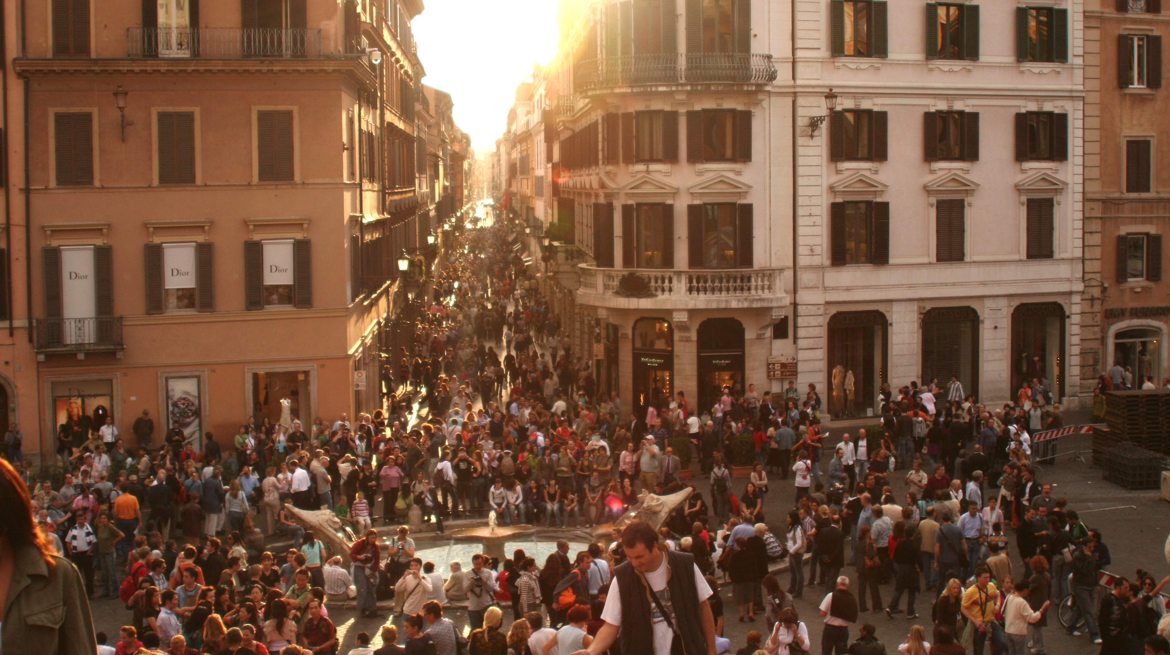
145,934,462
Population:
109,552,842
Internet population:
75.1%
Internet penetration:
https://www.worldometers.info/world-population/russia-population - mid-2020 estimate
https://www.internetworldstats.com/europa2.htm - December 2018
Notes:
Spacing – make sure pages like this don’t contain too much information and are nicely spaced out

Slide 2
145,934,462
Population:
109,552,842
Internet population:
75.1%
Internet penetration:
https://www.worldometers.info/world-population/russia-population - mid-2020 estimate
https://www.internetworldstats.com/europa2.htm - December 2018
Notes:
Spacing – make sure pages like this don’t contain too much information and are nicely spaced out
Change the colour of this background image: right click on the image > Format Picture… > choose the picture icon (top right) > Recolor > choose from the options provided

Slide 3
Search engine market shares
77.06%
17.94%
4.57%
https://www.worldometers.info/world-population/russia-population - mid-2020 estimate

Slide 4
Growth for key tech companies

Slide 5
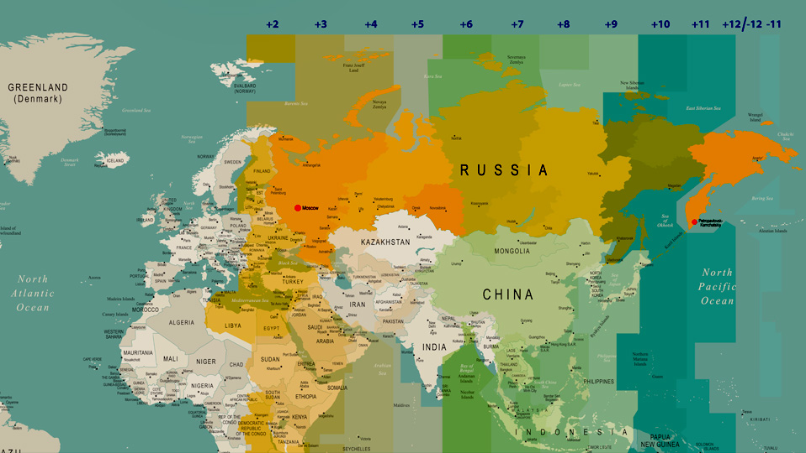
10am in Moscow
7pm in Kamchatka
Not one, not two… but 11 time zones

Slide 6
Internet usage stats
85% of Russian internet users access the internet every day (vs. 86% in the US).
Average daily time online is almost 6.5 hours.
90% of internet users stream video content – YouTube leads the way.
21% of internet users search with voice commands.

Slide 7
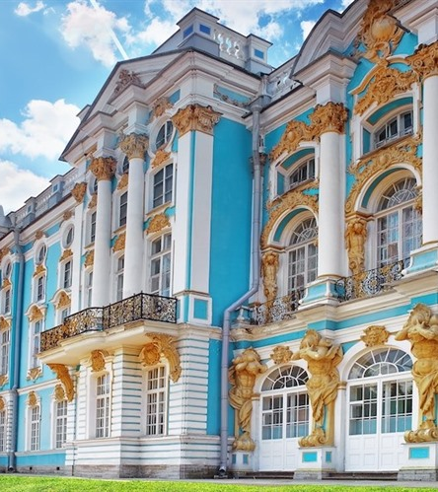
Internet usage stats
85% of Russian internet users access internet every day (vs. 86% in the US).
Average daily time online is almost 6.5 hours.
90% of internet users stream video content – YouTube leads the way.
St. Petersburg

Slide 8
CTAs
Direct CTAs like “Buy Today”, “Don’t Miss Out” etc… can have a negative impact.
Focusing more on the benefits and features can be more successful or less hard to sell, such as “Contact us” or “Learn more”.
Notes:
Change the colour of this background image: right click on the image > Format Picture… > choose the picture icon (top right) > Recolor > choose from the options provided

Slide 9
Key takeaways...
Data is your best friend.
Run all the A/B tests.
Be patient.
Treat each market as unique.
Notes:
Change the colour of this background image: right click on the image > Format Picture… > choose the picture icon (top right) > Recolor > choose from the options provided

Slide 10
Poll: Do you run an e-commerce business?
A
No.
B
I used to.
C
I would like to.
Notes:
Change the colour of this background image: right click on the image > Format Picture… > choose the picture icon (top right) > Recolor > choose from the options provided

Slide 11
Ten need-to-know facts about Russia
1
size
2
it varies
3
time spent online
4
dominated by local platforms
5
different seasonality

Slide 12
Ten need-to-know facts about Russia
6
Russians speak Russian
7
quality matters
8
transliteration will happen
9
cross-border shopping is big
10
price and deals are key

Slide 13
Does your site mention?
how to place an order
payment options
delivery options
suitable currency

Slide 14
A title here maybe?
Paid analytics tools
Maecenas cursus nunc pretium, efficitur lacus eu, malesuada ipsum.
Maecenas cursus nunc pretium, efficitur lacus eu, malesuada ipsum.
Maecenas cursus nunc pretium, efficitur lacus eu, malesuada ipsum.

Slide 15
UserTesting.com (qualitative)
1. Target
2. Engage
Maecenas cursus nunc pretium, efficitur lacus eu, malesuada ipsum.
Maecenas cursus nunc pretium, efficitur lacus eu, malesuada ipsum.
3. Discover
4. Share
Maecenas cursus nunc pretium, efficitur lacus eu, malesuada ipsum.
Maecenas cursus nunc pretium, efficitur lacus eu, malesuada ipsum.

Slide 16
The B2B marketing funnel
Awareness
The client searches for information.
Interest
The client examines specific products and reviews.
Consideration
The client shares research on products and brands with other stakeholders and decision makers.
Intent
Product/demo site visits.
Evaluation
The client gets a contact proposal negotiation.
Purchase
The transaction is completed – aftercare begins.
Notes:
To create more room on slides that are busy like this example, try adding the ‘Image section separator page with title’ slide before – you can then add the title to that page and remove it from this one.

Slide 17
Awareness
Interest
Consideration
Intent
Evaluation
Purchase
The client searches for information.
The client examines specific products and reviews.
The client shares research on products and brands with other stakeholders and decision makers.
Product/demo site visits.
The client gets a contact proposal negotiation.
The transaction is completed – aftercare begins.
Notes:
To create more room on slides that are busy like this example, try adding the ‘Image section separator page with title’ slide before – you can then add the title to that page and remove it from this one.

Slide 18
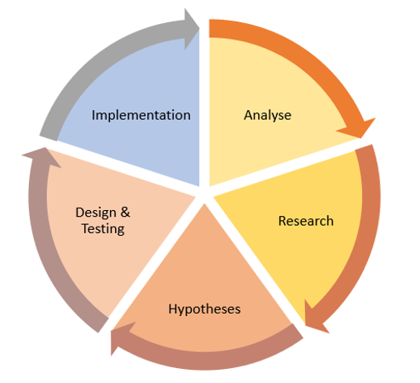
Step 1: Analyse
Identify potential areas for improvement and optimisation.
Benchmarks can help to evaluate performance.
Bounce rate | Performance
26% – 40% | Excellent
41% – 55% | Average
56% – 70% | Higher than average
70%+ | Disappointing
Research will help you identify key areas for improvement and form a hypothesis.

