Slide 1
Thank you, any questions?
in/kirstie-hoskin/
in/goncalvescesar/
Notes:
Change the colour of this background image: right click on the image > Format Picture… > choose the picture icon (top right) > Recolor > choose from the options provided

Slide 2
Thank you, any questions?
in/kirstie-hoskin/
in/goncalvescesar/
Notes:
Change the colour of this background image: right click on the image > Format Picture… > choose the picture icon (top right) > Recolor > choose from the options provided

Slide 3
Thank you, any questions?
in/kirstie-hoskin/
in/kirstie-hoskin/
in/goncalvescesar/
in/goncalvescesar/
Notes:
Change the colour of this background image: right click on the image > Format Picture… > choose the picture icon (top right) > Recolor > choose from the options provided

Slide 4
Thank you, any questions?
in/kirstie-hoskin/
in/kirstie-hoskin/
in/goncalvescesar/
in/goncalvescesar/
Notes:
Change the colour of this background image: right click on the image > Format Picture… > choose the picture icon (top right) > Recolor > choose from the options provided

Slide 5
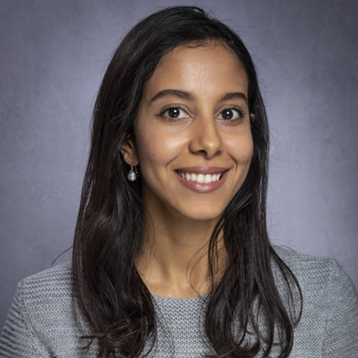
Connect with us!
Kirstie Hoskin
Events and Marketing Manager
kirstie.hoskin@webcertain.com
/in/kirstie-hoskin
Lamyaa Nadim
Social Media and Influencer Marketing Executive
lamyaa.nadim@webcertain.com
/in/lamyaa-nadim
Notes:
Change the colour of this background image: right click on the image > Format Picture… > choose the picture icon (top right) > Recolor > choose from the options provided

Slide 6
Thank you, any questions?
Kirstie Hoskin
Events and Marketing Manager
kirstie.hoskin@webcertain.com
/in/kirstie-hoskin
Lamyaa Nadim
Social Media and Influencer Marketing Executive
lamyaa.nadim@webcertain.com
/in/lamyaa-nadim
Notes:
End slide 2

Slide 7
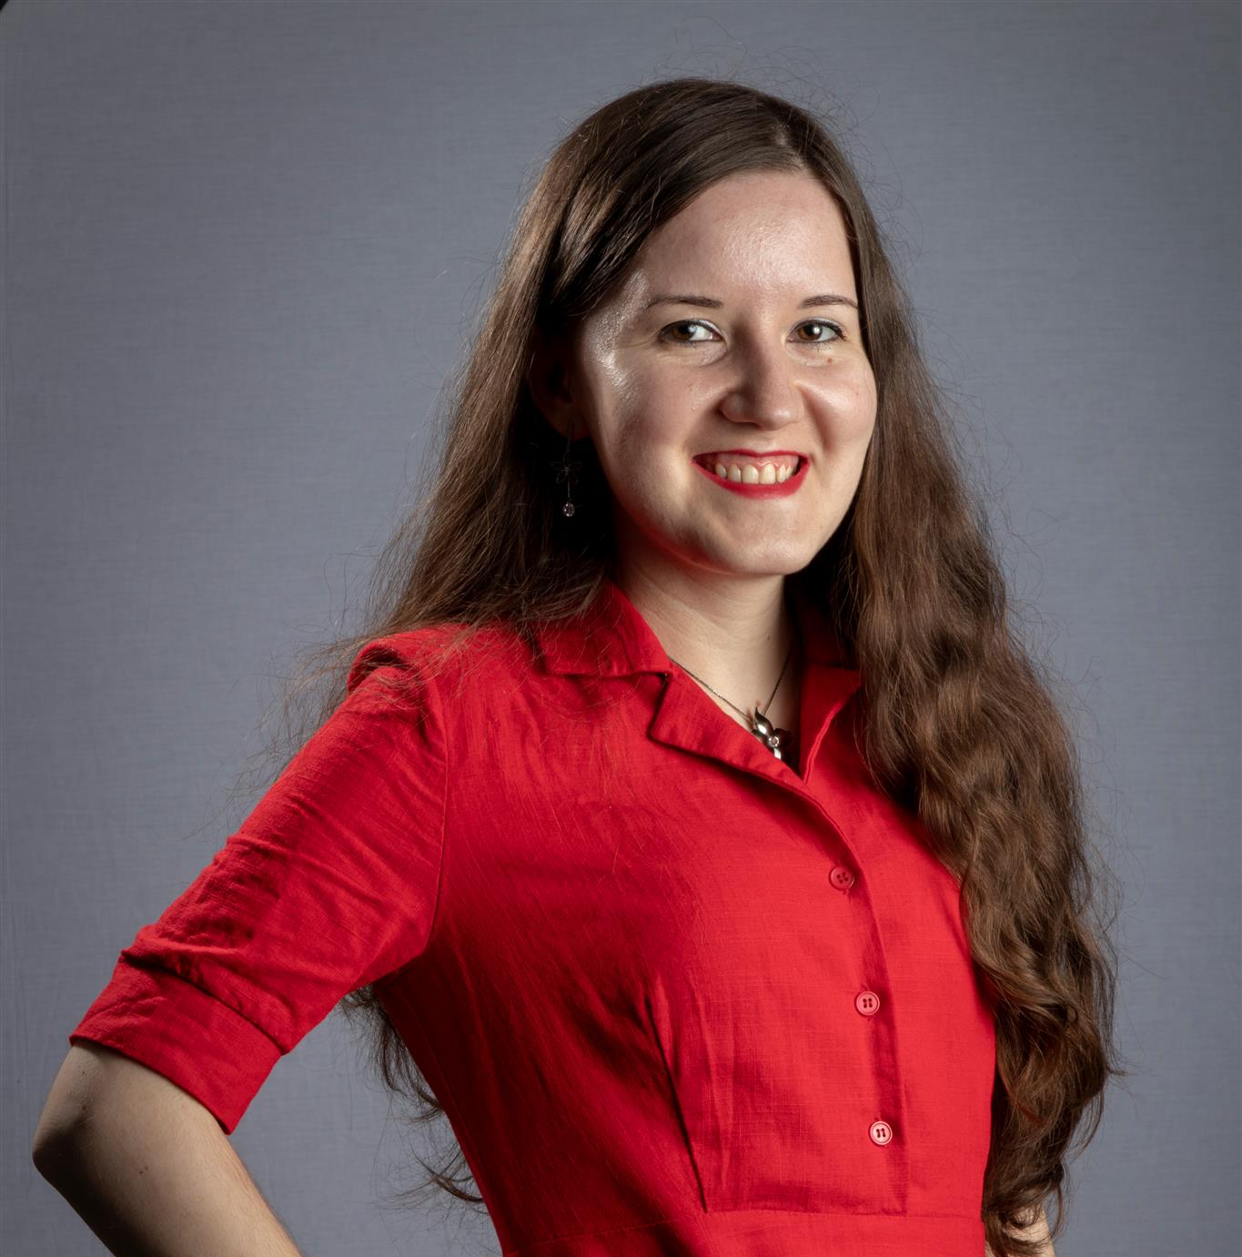
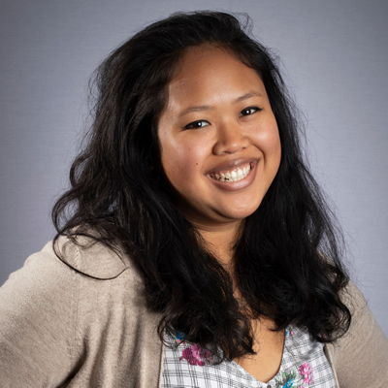
Connect with us!
Kirstie Hoskin
Lamyaa Nadim
Events and Marketing Manager
Social Media and Influencer Marketing Executive
kirstie.hoskin@webcertain.com
/in/kirstie-hoskin
lamyaa.nadim@webcertain.com
/in/lamyaa-nadim
Daiana Damacus
Anlieka Marconi
General Manager - Social Media and Influencer Marketing
Social Media and Influencer Marketing Specialist
daiana.damacus@webcertain.com
/in/daianadamacus
anlieka.marconi@webcertain.com
/in/anliekamarconi
Notes:
Change the colour of this background image: right click on the image > Format Picture… > choose the picture icon (top right) > Recolor > choose from the options provided

Slide 8
Connect with us!
Kirstie Hoskin
Lamyaa Nadim
Events and Marketing Manager
Social Media and Influencer Marketing Executive
kirstie.hoskin@webcertain.com
/in/kirstie-hoskin
lamyaa.nadim@webcertain.com
/in/lamyaa-nadim
Daiana Damacus
Anlieka Marconi
General Manager - Social Media and Influencer Marketing
Social Media and Influencer Marketing Specialist
daiana.damacus@webcertain.com
/in/daianadamacus
anlieka.marconi@webcertain.com
/in/anliekamarconi
Notes:
Change the colour of this background image: right click on the image > Format Picture… > choose the picture icon (top right) > Recolor > choose from the options provided

Slide 9
Let us help you!
If you need any help, advice or have a question related to any of these slides, or have a new design idea/request please let us know by either:
Contacting Gemma (gemma.houghton@webcertain.com)
Contacting the Creative team (development@webcertain.com)
Notes:
End slide 3

Slide 10
Let us help you!
If you need any help, advice or have a question related to any of these slides, or have a new design idea/request please let us know by either:
Contacting Gemma (gemma.houghton@webcertain.com)
Contacting the Creative team (development@webcertain.com)
Notes:
End slide 3

Slide 11
Notes:
End slide 4

Slide 12
Notes:
End slide 4

Slide 13
Notes:
End slide 5

Slide 14
Notes:
End slide 5

Slide 15
Notes:
End slide 6

Slide 16
Notes:
End slide 6

